Slide 1


DR1 Presentation: LANL
9/11/2024
Izzy Baumler, Dalton Boeckmann, Morgan Gullo, Jade Waldron

Slide 2
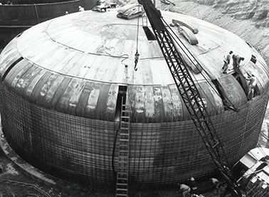
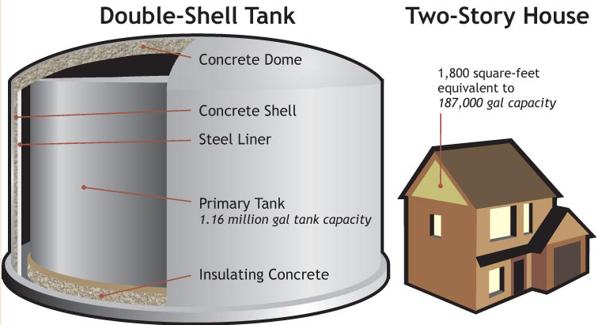
Background
Located in Southeastern Washington, the Hanford Site was created during WW2 and the Cold War to create plutonium for nuclear weapons
56 million gallons of nuclear waste were produced and stored in 177 tanks since 1943. Tri-Party agreement (1989) initiated cleanup efforts.
Tank AY-102 outer shell leak in 2012 led to a federal court order as it was close to contaminating nearby Columbia river

Slide 3
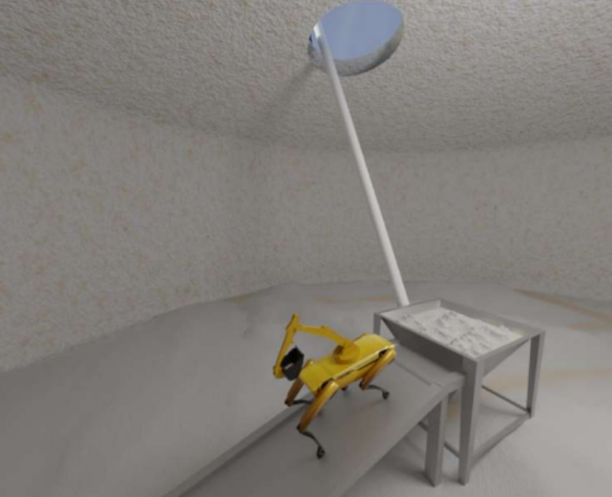
Background
DOE currently uses Slurry Mobilization Techniques to transport waste between tanks
Inefficient with solid waste chunks and increased waste volume
Dry Retrieval Method is a faster yet costly method requiring new infrastructure
Objective: Our team is designing a robotic arm attachment for a Boston Dynamics Spot Robot to clean tank walls. The arm will replicate human arm mobility and use various tools (cutters, grinders, sanders) to break down waste in varying consistencies.

Slide 4
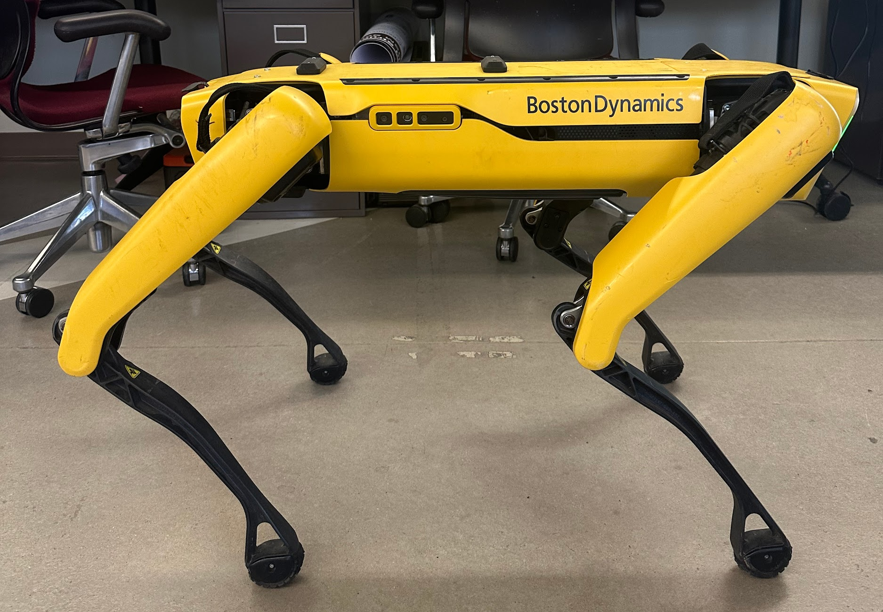
Boston Dynamics Spot Robot
Boston Dynamics' Spot: A quadruped robot capable of navigating various terrains, including hazardous environments, for tasks like data collection and incident response.
Lidar Technology: Uses 3D laser scanning for quick and accurate environmental mapping, aiding in navigation.
Data Collection: Equipped with five stereo cameras and sensors to collect visible images, 3D scans, and thermal images.
Obstacle Avoidance: Spot avoids obstacles taller than 30 cm to maintain balance using its camera system.
Industrial Use: Used in industries like construction to enhance safety and efficiency by performing dangerous tasks.

Slide 5
Control Systems
Control Systems: Essential for precise movement and coordination of robotic arms, employing methods like PID controllers for basic operations.
Proportional-integral-derivative controller: Used for most basic joint control operations
Model Predictive Control: Not suitable for tasks with unpredictable physical interactions, such as handling unknown materials

Slide 6
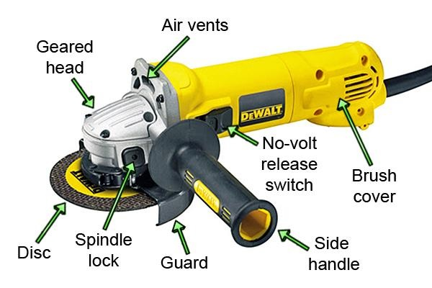
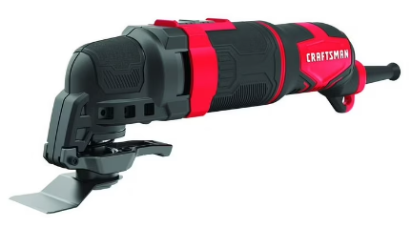
Power Tool Arm Attachments
Vibratory Cutters / Oscillating Tool
Angle Grinders
Vibratory cutters feature a small blade that’s fixed on one end while the other end moves rapidly back and forth in a motion similar to that of a pendulum swing
Combination of vibration and sawing works well for cutting materials like metal, drywall, and wood
Avg Weight 3.4 lbs, Speed: 8k-20k OPM
Angle grinders are handheld power tools used for grinding and polishing
Common uses for an angle grinder include: Cutting ceramic tiles, cutting stone, cutting metal, removing paint, removing rust, removing mortar, cleaning metal, cutting and carving wood
Avg Weight 3-5 lbs, Speed 8k-9k RPM

Slide 7
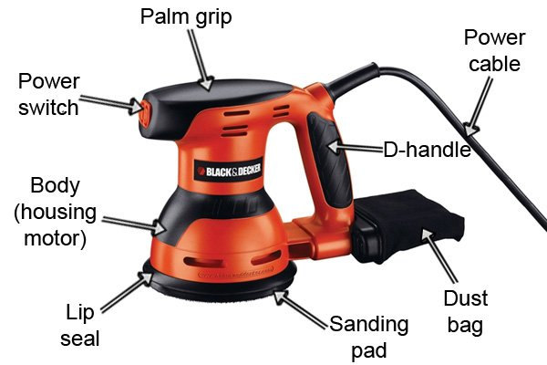

Power Tool Arm Attachments
Drill Brushes
Sanders
A cleaning drill brush is an attachment that fits into a regular drill, allowing the user to harness the drill’s power for scrubbing surfaces
Practical for heavy-duty cleaning scenarios such as ovens, grills, and grates that require power
Smaller brushes start at 4 ounces whereas larger brushes can be as heavy as 12 ounces
A power sander is a handheld or stationary tool used to smooth surfaces by abrasion with sandpaper
Cordless Orbital Sanders generally weigh between 2 to 4.5 pounds, operate with a battery voltage of about 18 to 20 Volts (V), and have varying Amp-hour ratings from around 2.0 Ah to 4.0 Ah

Slide 8
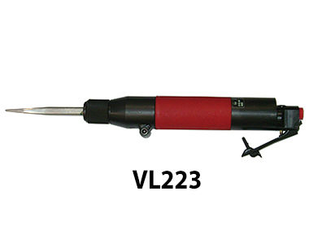
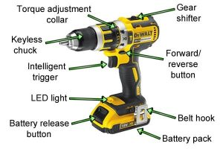
Power Tool Arm Attachments
Vibration Chisel Scaler
Drills
Vibration Chisel Scalers remove coatings, corrosion, and other accumulated materials. It can also perform splitting, chipping, pointing, and brick raking
They are pneumatic tools, meaning they are powered by compressed air rather than batteries
A drill is a power tool that uses a rotating drill bit. They are used to create holes in various materials such as wood, plastic, and metal
Average-sized cordless drill will weigh about 2-3 pounds and provide around 2 amp hours of battery life

Slide 9
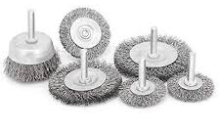
Power Tool Arm Attachments
Wire Wheels
Commonality of Attachments
Wire wheels are a set of wire bristles mounted on a hub
Ideal for removing rust, paint, weld splatter, dust, debris from surfaces, smoothing rough edges, polishing metal, and blending welds
Smaller wire wheel brushes often weigh less than 2 pounds
Poses a unique challenge in terms of mounting and compatibility with the robot
Each tool has its requirements for power supply, rotational speed, torque, and weight, all of which must be compatible with a universal attachment system
Popular Quick-Change Tool Systems exist, however they are industrial sized robots

Slide 10
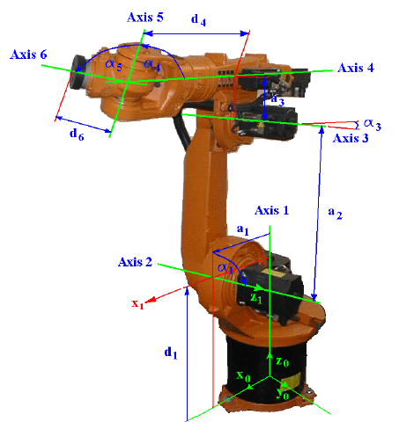
Kinematic and Dynamic Considerations for the Design of a 7-DoF Robotic Arm
Research Goal: Analyze the basic principles of kinematics and dynamics for a 7-degree-of-freedom (7-DOF) robotic arm.
Define how the end-effector position is described relative to the base.
Determine the possible workspace from these calculations.
Utilize mathematical calculations to relate joint operations to the end-effectors kinematic and dynamic characteristics.
Denavit-Hartenberg (DH) Convention:
Each link and joint is defined by four parameters:
Link length (a)
Link twist (α)
Joint offset (d)
Joint angle (Ө)
Assigning Coordinate Frames:
Coordinate frames are assigned such that axes z align with the joint axis of each link.
For revolute joints: is the axis of rotation.
For prismatic joints: is the axis of translation.
Example of Denavit-Hartenberg Convention Application - NOT our robot
Notes:
Kinematics in Robotics:
Essential for understanding how each joint movement affects the end-effector position and orientation.
Frame Assignment for Subsequent Joints:
Three cases for positioning of (previous joint axis):
Non-coplanar: Not lying in the same panel
Parallel: Lying along the same direction.
Intersecting: Crossing each other.
Each case uses specific methods to determine the following x and y axis.

Slide 11
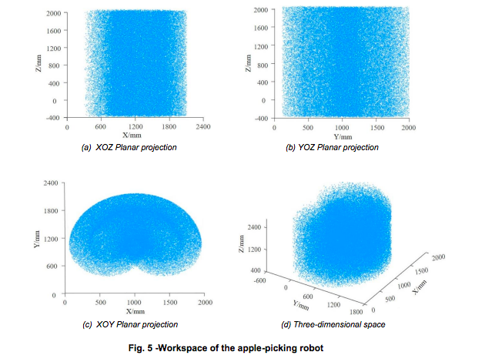
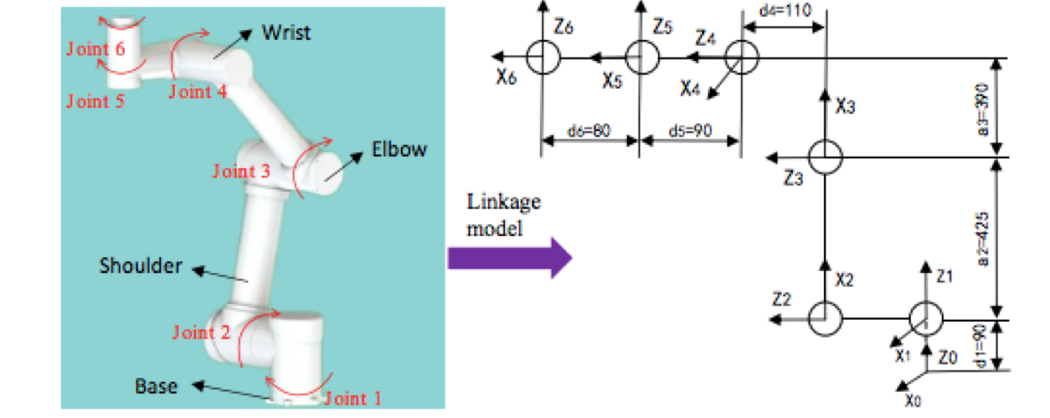
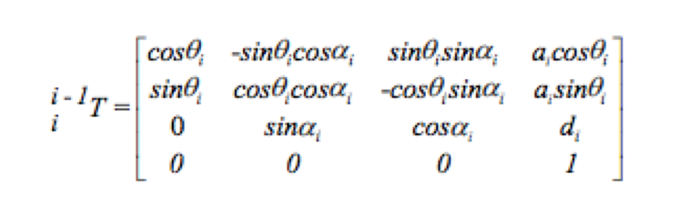
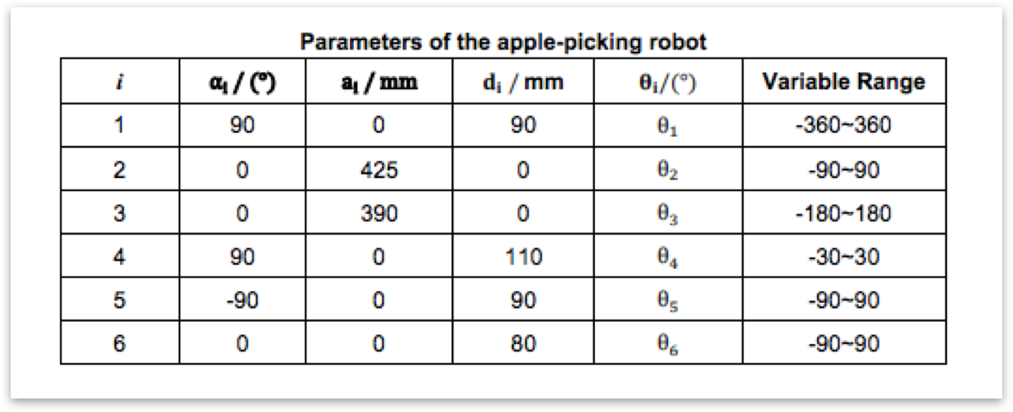
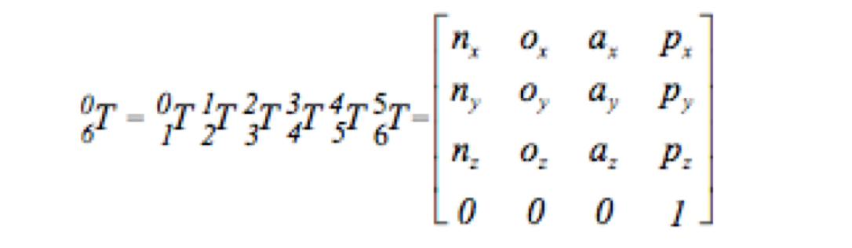
Recent Application: DESIGN AND EXPERIMENT OF CLAMPING-PULL-OFF APPLE PICKING ROBOT
Study on Clamping Robot for Apple Picking:
Designed a 6-DOF robotic system for picking apples from trees.
Analyzed each joint using the Denavit-Hartenberg (DH) convention
Denavit-Hartenberg (DH) Parameter Analysis:
Parameters analyzed: link length (a), link twist (α), joint offset (d), and joint angle (Ө).
Results tabulated
Homogeneous Transformation Matrix:
Utilized to compute the transformation matrix for each joint
Determines the end-effector's position and orientation relative to the base frame using forward kinematics.
Equation 1: Formulates the transformation matrix.
Forward Kinematics:
Calculations derived from DH parameters to relate the end-effector's orientation to the base frame.
System of equations for orientation and position.
Key Outputs of Forward Kinematics
n: Direction cosines aligning end-effector with base axes.
o: Rotational offsets.
a: Link length affecting joint distances and robot reach.
p: Position vector specifying the end-effector's location in 3D space.
Notes:
Through the forward kinematics Equations obtained , the position vector of the end-effector relative to the base was solved, and then
multiple end position coordinate points were randomly generated by the Rand function to obtain the workspace as shown in Figure 5
Why is this useful, this will help trajectory planning for design for operation process

Slide 12
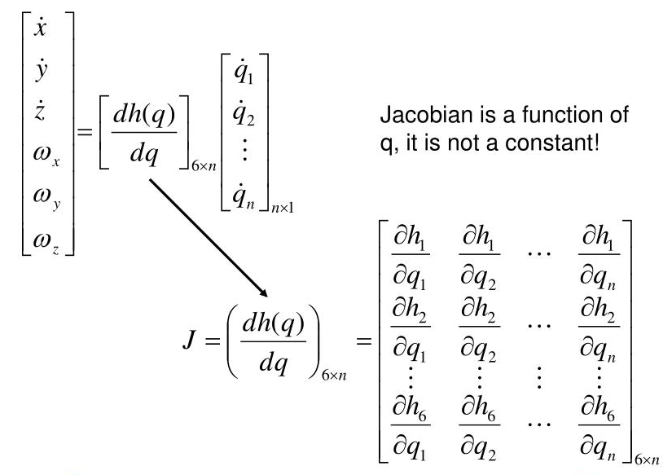
Jacobian Matrix and Its Applications
The DH convention help to establish the position and orientation of each link relative to its preceding link. The transformations between these frames are essential for calculating the position and orientation of the end-effector.
Jacobian Matrix Calculation:
The Jacobian matrix relates the velocities of the robot's joints to the linear and angular velocities of the end-effector.
The Jacobian matrix is derived from the partial derivatives of the position and orientation of the end-effector with respect to each joint variable (either joint angle for revolute joints or joint displacement for prismatic joints).
The calculation of the Jacobian matrix is greatly simplified by using the DH parameters to define the robot's kinematic chain.
Application of Jacobian Matrix
Help the team map Joint Torques for Force Control of the end effector
Aids in redundancy resolution, helping optimize joint configurations to avoid unnecessary energy use, joint limits, or obstacles in confined spaces like nuclear waste tanks
Notes:
The significance of this research will become evident as the project progresses. The team will utilize simulation and real-time modeling to analyze the motion of the 7-degree-of-freedom robot arm. Understanding and Utilizing these concepts is not purely theoretical; it forms the basis for optimizing the robot's design parameters, creating efficient control systems, and integrating advanced technologies like passive force control

Slide 13
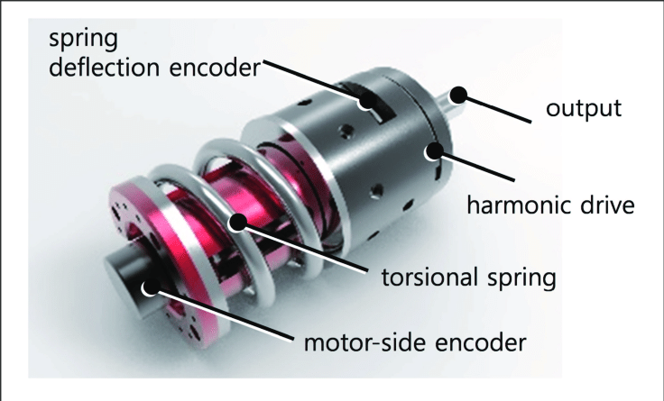
Passive Force Control
[5] “Force Control Basics.” PushCorp, https://pushcorp.com/wp-content/uploads/2020/06/Force-Control-Basics.pdf. Accessed 8 September 2024.
[6] Andrea Calanca, Riccardo Muradore, Paolo Fiorini, Impedance control of series elastic actuators: Passivity and acceleration-based control, Mechatronics, Volume 47, 2017, Pages 37-48, ISSN 0957-4158, https://doi.org/10.1016/j.mechatronics.2017.08.010.
Passive Force Control
Hybrid force control system- Series Elastic Actuators
Included to minimize the potential to damage the walls of the tank
Elastic element can act as a buffer between the motor and load
Spring deformation is directly proportional to the force exerted
Must determine stiffness of spring

Slide 14
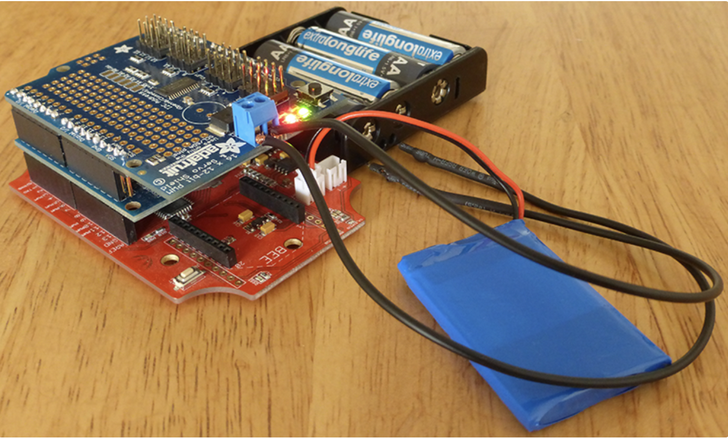
Human Control Interface
“Build your own robot arm - remote control.” Jakub Staš, 7 August 2015, https://jakubstas.com/build-your-own-robot-arm-remote-control/. Accessed 8 September 2024.
Joystick/Handheld Controller
Manually input operations to manipulate the arm
Uses switches, buttons, triggers, and thumbsticks
Wireless connection → Bluetooth-enabled
Must include USB Host Shield, Bluetooth adapter, and an Arduino IDE
Powered through a battery pack or direct connection to robo dog

Slide 15
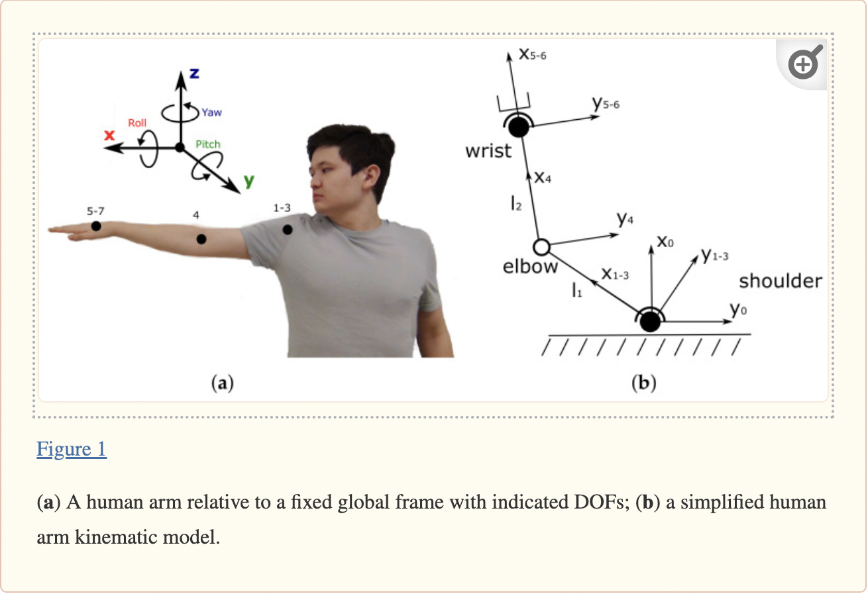
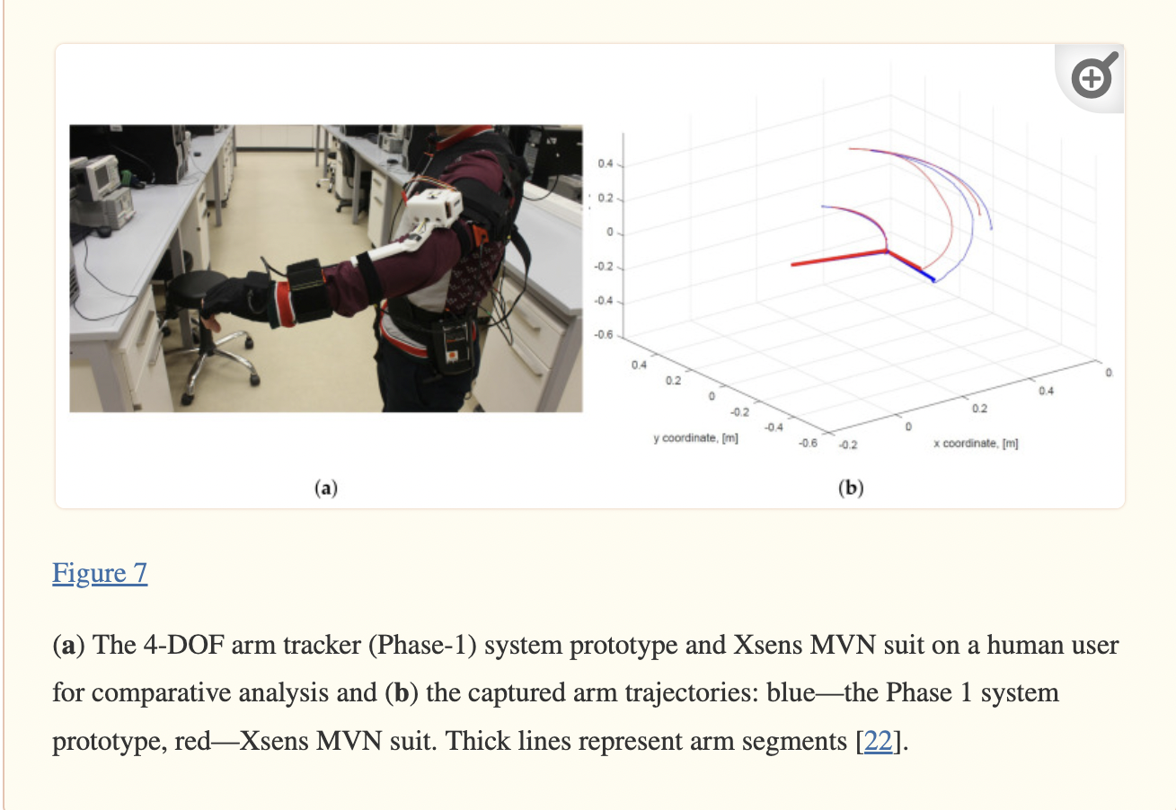
Human Control Interface
Shintemirov A, Taunyazov T, Omarali B, Nurbayeva A, Kim A, Bukeyev A, Rubagotti M. An Open-Source 7-DOF Wireless Human Arm Motion-Tracking System for Use in Robotics Research. Sensors (Basel). 2020 May 29;20(11):3082. doi: 10.3390/s20113082. PMID: 32485977; PMCID: PMC7309037.
Motion Capture Suits
Wearable sleeve that is directly connected to the robotic arm
Equipped with sensors that can track body movements

